Slide 1
Lists in Python

Slide 2
Introduction
List is a sequence of values called items or elements.
The elements can be of any data type.
The list is a most versatile data type available in Python which can be written as a list of comma- separated values (items) between square brackets.
List are mutable, meaning, their elements can be changed.

Slide 3
Creating Lists
In Python programming, a list is created by placing all the items (elements) inside a square bracket [ ], separated by commas.
It can have any number of items and they may be of different types (integer, float, string etc.).
Method -1 without constructor # empty list
my_list = []
# list of integers my_list = [1, 2, 3]
# list with mixed datatypes
my_list = [1, "Hello", 3.4]
# nested list
my_list = [“welcome", [8, 4, 6]]
Method-2 using list constructor
# empty list
my_list = list()
# list of integers my_list = list([1, 2, 3])

Slide 4
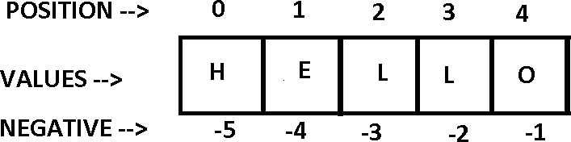
About Item Positioning
Or Reverse indexing

Slide 5
Accessing the elements of the list
Index operator [] is used to access an item in a list. Index starts from 0
marks=[90,80,50,70,60]
print(marks[0])
Output: 90
Nested list:
my_list = [“welcome", [8, 4, 6]]
Print(marks[1][0])
Output: 8

Slide 6
List access – negative indexing
Python allows negative indexing for its sequences. The index of - 1 refers to the last item, -2 to the second last item and so on
my_list = ['p','r','o','b','e']
# Output: e
print(my_list[-1])
# Output: p print(my_list[-5])

Slide 7
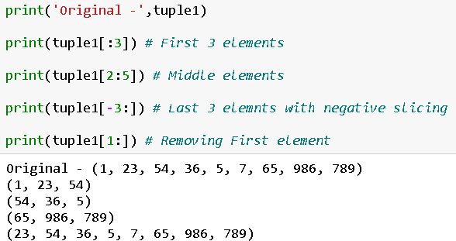
Slicing in Lists
Slicing of a list is done to fetch a specific set or slice of sub-elements.
Slicing can also be done to other collection data types such as tuples and arrays.
We can access a range of items in a list by using the slicing operator.
When stop value is given then just
→ Representation - [ start: stop -1: step].

Slide 8
Altering the elements of the list
#Add Elements
add one item to a list using append()
method
add several items using extend()
insert one item at a desired location by using the method insert()
>>> marks.append(50)
>>> print(marks)
[90, 100, 80, 50]
#Change Elements
= operator with index
>>> marks=[90,60,80]
>>> print(marks)
[90, 60, 80]
>>> marks[1]=100
>>> print(marks)
[90, 100, 80]
>>> marks.extend([60,80,70])
>>> print(marks)
[90, 100, 80, 50, 60, 80, 70]
>>> marks.insert(3,40)
>>> print(marks)
[90, 100, 80, 40, 50, 60, 80, 70]

Slide 9
Deleting the elements of the list
delete one or more items from a list using the keyword del.
It can even delete the list entirely.
>>> print(marks)
[90, 100, 80, 40, 50, 60, 80, 70]
>>> del marks[6]
>>> print(marks)
[90, 100, 80, 40, 50, 60, 70]
>>> del marks
>>> print(marks)
Name Error: name 'marks' is not
defined
clear() method to empty a list.
>>> marks.clear()
>>> print(marks)
[]
remove() method to remove the given item
>>> marks=[90,60,80]
>>> marks.remove(80)
>>> print(marks) [90, 60]
>>> marks.remove(100) Traceback
(most recent call last):
File "<pyshell#1>", line 1, in <module>
marks.remove(100)
ValueError: list.remove(x): x not in list
pop() method to remove an item at the given index.
>>> marks=[100,20,30]
>>> marks.pop() 30
>>> print(marks) [100,
20]
>>> >>> marks.pop(0) 100
>>> print(marks) [20]
delete items in a list by assigning an empty list to a slice elements. marks=[100,20,30]
>>> marks[1:2]=[]
>>> print(marks) [100, 30]

Slide 10
Slicing [::] (i.e) list[start:stop:step]
Concatenation = +
Repetition= *
Membership = in
Identity = is

Slide 11
List Slicing
Accessing the range of item of the list by using the slicing operator [:]
Slicing can be best visualized by considering the index to be between the elements.
Example : -
marks=[90,80,50,70,60]
print(marks[:2])
Output: [90,80]
list_st = [‘h’,’e’,’l’,’l’,’o’]
print(list_st[:2])
Output: [‘h’,’e’]
marks=[100,70,200,150,60]
print(marks[-2:])
Output: [150,60]

Slide 12


append() - Add an element to the end of the list
extend() - Add all elements of a list to the another list
insert() - Insert an item at the defined index
remove() - Removes an item from the list
pop() - Removes and returns an element at the given index
clear() - Removes all items from the list
index() - Returns the index of the first matched item
count() - Returns the count of number of items passed as an argument
sort() - Sort items in a list in ascending order
reverse() - Reverse the order of items in the list
copy() - Returns a shallow copy of the list

Slide 13
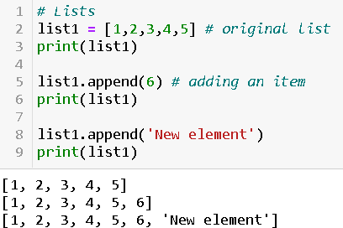
Append Method
The append() method adds an item to the list.
It only modifies the current list and does not return any value.
It adds the element to the end of the list.
It can append any data type value such as string, list, tuple, integer, array.
Syntax →
list.append(element)
Example →

Slide 14
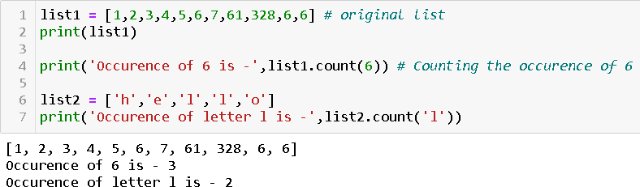
Count Method
Count() method counts how many times an element occurs in a list
It takes in the single argument i.e. an element/item whose count is required.
It returns the number which specifies the item occurence.
Syntax →
list.count(element)
Example →

Slide 15
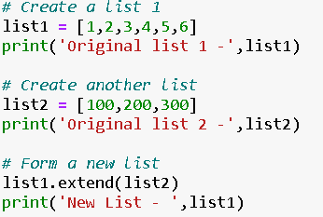

Extend Method
It extends the list by adding the items to another list.
It takes in the single argument i.e. an element/item and adds in the end of list.
This method also add items of other data types like tuple, set etc
Syntax →
list1.extend(element/list2)
Example →

Slide 16
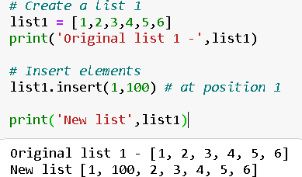
Insert method
It inserts the item on the particular index.
It takes in the two arguments – index and item.
It does not return anything but only inserts item in the list.
Syntax →
list1.insert(index,element)
Example →

Slide 17
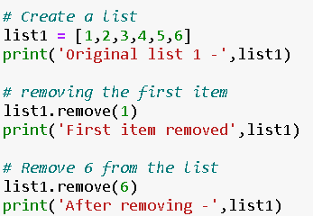

Remove method
This method searches for the given element in the list and removes it based on a match.
It takes single element as an argument and removes it from the list.
If the value is not present in the list then it will throw an error.
Syntax →
list1.remove()
Example →

Slide 18
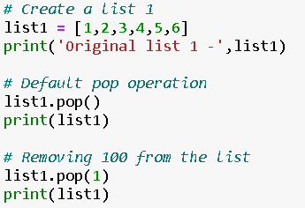

Pop method
It takes in single item and removes the item from the end of the list by default.
If the index passed which is not present then it will throw an error
It updates the list once pop operation is performed
Syntax →
list1.pop(index)
Example →

Slide 19
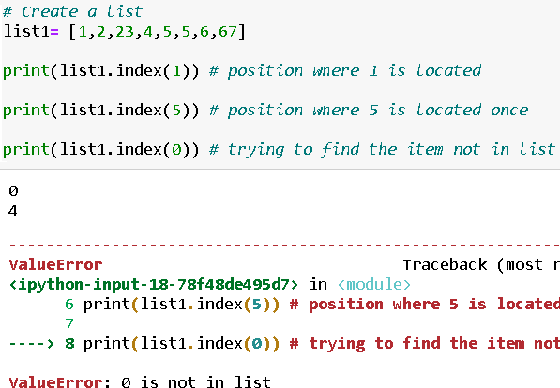
Index method
Index method is search and find given item in the list and returns it’s position.
If the item is already present in the list then item on smallest position index is returned.
Index starts from 0 and not 1.
It takes in the single argument and returns the position of the item.
Syntax →
list1.index(element)
Example →

Slide 20
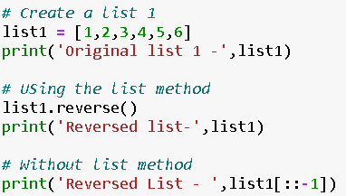

Reverse method
It simply reverses the list.
It does not return anything, just reverses the list and updates it
Syntax →
list1.reverse()
Example →

Slide 21
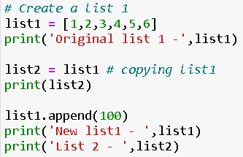

Copy method
It returns the shallow copy of the list
We can do it like –
Old_list = [1,2,3]
New_list = old_list
New_list = [1,2,3]
The problem with this method if we change the old_list then new_list will also gets changed. Hence, copy method is there to save us.
Example →
Automatically changed

Slide 22
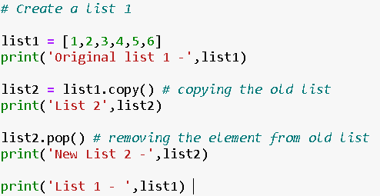

Shallow Copy
We need other lists to remain unchanged when original list is modified.
This is called Shallow Copy
It does not take any parameters and returns the list which is copied.
Syntax →
list2 = list1.copy()
Example →

Slide 23
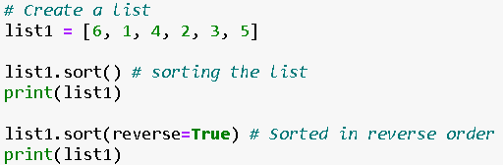

Sort method
This method sorts the given list in specific order – ascending / descending.
It takes no argument and updates the original list.
Syntax →
list1.sort()
Example →

Slide 24
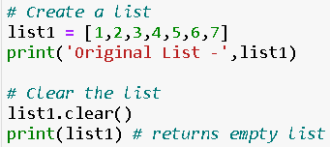

Clear method
This method clears the whole list and returns an empty list.
It takes no argument.
Syntax →
list1.clear()
Example →

